Slide 1

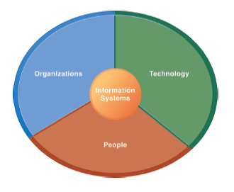
The Institute of Finance Management
ITU08117:
Information Systems Management
BAIT III
Mugyabuso, M. L
2022-2023
Notes:
There are two video cases and two instructional videos available for this chapter.

Slide 2
Achieving Competitive Advantage with Information Systems

Slide 3
Using Information Systems to Achieve Competitive Advantage
Porter’s Competitive Forces Model
One way to understand competitive advantage
Five competitive forces shape fate of firm
Traditional competitors
Competitors in market space continuously devise new products, new efficiencies, switching costs
New market entrants
Some industries have low barriers to entry:
E.g., food industry versus microchip industry
Newer companies may have advantages:
Newer equipment, younger workforce, and so on.
Notes:
Porter’s model is the best known model of competitive advantage. Now more than thirty years old, it still provides a nice summary of the strategic situation of firms in a larger business environment. The model focuses on industry structure (or the environment of the firm) as the main determinant of management decisions about corporate strategies. Managers don’t just make up strategies out of thin air. They look at the competitive situation in their industry, and then consider ways of coping and succeeding in that environment.

Slide 4
Using Information Systems to Achieve Competitive Advantage
Porter’s Competitive Forces Model
Substitute products and services
Substitutes customers can purchase if your prices too high
E.g., Internet music service versus CDs.
Customers
Can customers easily switch to competitor’s products?
Can customers force firm and competitors to compete on price alone (transparent marketplace)?
Suppliers
The more suppliers a firm has, the greater control it can exercise over suppliers.

Slide 5
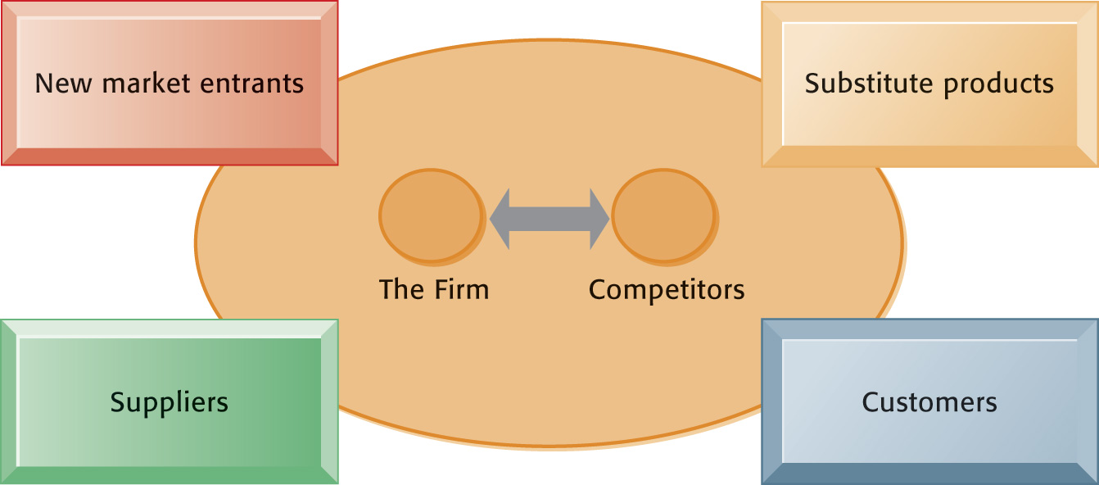
Using Information Systems to Achieve Competitive Advantage
Porter’s Competitive Forces Model
In Porter’s competitive forces model, the strategic position of the firm and its strategies are determined not only by competition with its traditional direct competitors but also by four forces in the industry’s environment: new market entrants, substitute products, customers, and suppliers.
Figure 3-1
Notes:
A good way to teach this model is to take a specific industry and ask students to fill in the boxes in the model (starting with the environmental boxes). Any industry can be analyzed: automobiles, PC computers, smartphones, and so on.

Slide 6
Using Information Systems to Achieve Competitive Advantage
Information System Strategies for Dealing with Competitive Forces
Basic strategy: Align IT with business objectives
75 percent of businesses fail to align their IT with their business objectives, leading to lower profitability
To align IT:
Identify business goals and strategies
Break strategic goals into concrete activities and processes
Identify metrics for measuring progress
Determine how IT can help achieve business goals
Measure actual performance
Notes:
Information systems often play a critical role in defining and achieving strategic objectives of the firm. Sometimes, IS is tangential: Coca Cola for instance is not an intense technology user, and maintains its differentiated product through marketing and branding efforts. Other firms are intensely using IS to achieve competitive advantages, from Walmart to Facebook, Amazon, and Google.
The first step in using information systems to serve your firm is to make sure the IS objectives are lined up with the business objectives.

Slide 7
Using Information Systems to Achieve Competitive Advantage
Information System Strategies for Dealing with Competitive Forces
Low-cost leadership
Use information systems to achieve the lowest operational costs and the lowest prices
E.g., Sarafu
Inventory replenishment system receives orders from retailers and mid-distributors.
Minimizes inventory at warehouses, operating costs
Efficient customer response system
Notes:
In the physical retail industry, including groceries, the keys to success are efficiency in moving product through your pipeline, minimizing inventory and time delays between receipt of the goods, and the customer purchase.

Slide 8
Using Information Systems to Achieve Competitive Advantage
Information System Strategies for Dealing with Competitive Forces
Product differentiation
Use information systems to enable new products and services, or greatly change the customer convenience in using your existing products and services
E.g., Google’s continuous innovations, Apple’s iPhone
Use information systems to customize, personalize products to fit specifications of individual consumers
E.g., Nike’s iD program for customized sneakers
Notes:
Ask students to help you make a list of companies that have really unique products or services. It’s fun to ask students for local firms on this list. There may be a really unique pizza store, theater, or restaurant in the neighborhood to help illustrate the point about product differentiation as a competitive strategy.

Slide 9
Using Information Systems to Achieve Competitive Advantage
Information System Strategies for Dealing with Competitive Forces
Focus on market niche
Use information systems to enable specific market focus, and serve narrow target market better than competitors
Analyzes customer buying habits, preferences
Advertising pitches to smaller and smaller target markets
E.g., Hilton Hotel’s OnQ System
Analyzes data collected on guests to determine preferences and guest’s profitability
Notes:
Ask students for Web stores that appeal to a very small niche market, e.g., people with unique hobbies, special interests, or different political and cultural views.

Slide 10
Using Information Systems to Achieve Competitive Advantage
Information System Strategies for Dealing with Competitive Forces
Strengthen customer and supplier intimacy
Strong linkages to customers and suppliers increase switching costs and loyalty
Toyota: uses IS to facilitate direct access from suppliers to production schedules
Permits suppliers to decide how and when to ship supplies to plants, allowing more lead time in producing goods.
Amazon: keeps track of user preferences for purchases, and recommends titles purchased by others
Notes:
Ask students to describe and discuss firms that they believe really “care about the customer” or offer great customer service. If this proves difficult, ask them to talk about companies with really poor customer service. Everybody knows a really poor customer service organization. In these discussions, ask students how IS could help improve the relationship with the customer.

Slide 11
Essentials of Management Information Systems
Chapter 3 Achieving Competitive Advantage with Information Systems
Using Information Systems to Achieve Competitive Advantage
Information System Strategies for Dealing with Competitive Forces
Successfully using IS to achieve competitive advantage requires precise coordination of technology, organizations, and people
Notes:
Some firms pursue multiple strategies although many pursue a single strategy. Apple, for instance, pursues highly differentiated products that it sells at a premium price. It rarely if ever pursues a low cost strategy. General Motors pursues both high-priced differentiated products (GMC Yukons and Cadillac) and low-priced economy cars (Chevy Cruze). Like other global auto companies such as BMW, Mercedes Benz, Ford, Toyota, and others, GM pursues a competitive scope strategy as well by developing “world models” of its cars that sell in many countries, lowering design and production costs.

Slide 12
Using Information Systems to Achieve Competitive Advantage
The Internet’s Impact on Competitive Advantage
Enables new products and services
Encourages substitute products
Lowers barrier to entry
Changes balance of power of customers and suppliers
Transforms some industries
Creates new opportunities for creating new markets, building brands, and large customer bases
Notes:
Ask students to help you put together a list of industries that have been greatly impacted by the Internet and the Web. Then for each industry, ask them to describe how the Internet has changed the industry. How has the Internet changed that industry from a consumer perspective? Can students think of some industries that have been destroyed by the Internet? Or greatly changed? Record stores, video stores, and small local bookstores come to mind.

Slide 13
Using Information Systems to Achieve Competitive Advantage
The Business Value Chain Model
Highlights specific activities in a business where competitive strategies can best be applied and where information systems are likely to have a strategic impact
Primary activities
Support activities
Benchmarking
Best practices
Notes:
Porter’s industry analysis is not the only competitive strategy model. In the business chain (really a business process model), firms achieve competitive advantages by being more efficient. This does not mean low-priced. The gains from efficiency may be retained by the firm as greater profits, depending on the competitive situation. For instance, Walmart adopts a business value chain model to achieve the lowest prices, but not so low as to report lower profits.

Slide 14
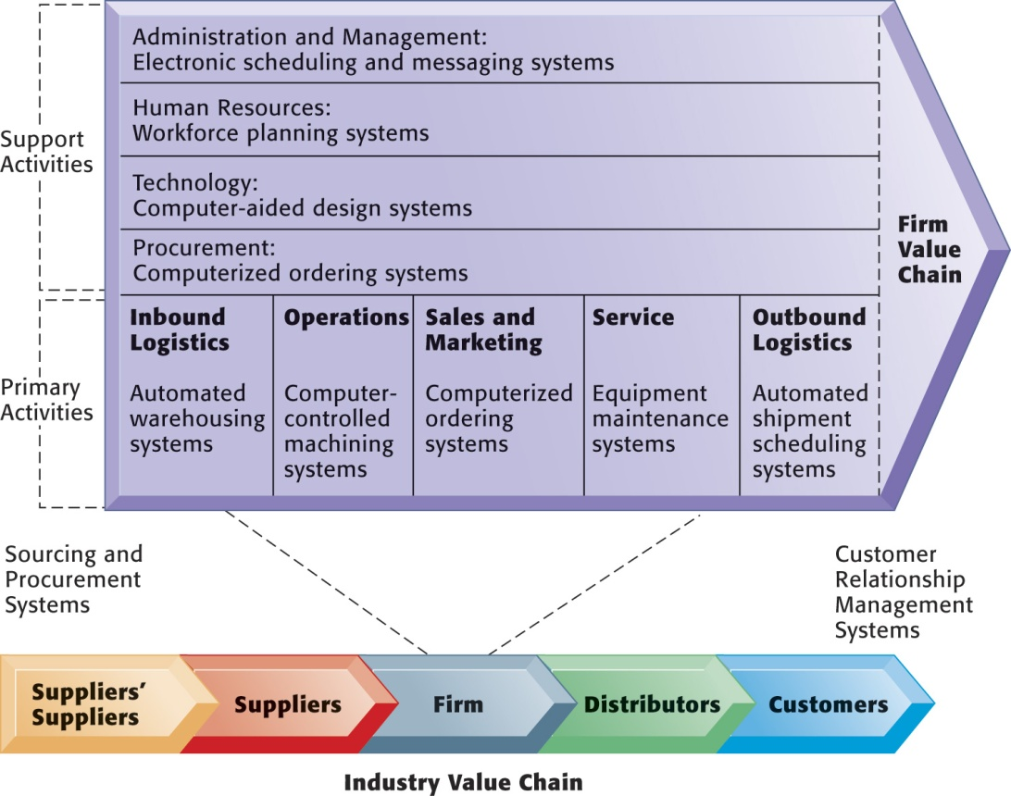
Using Information Systems to Achieve Competitive Advantage
The Value Chain Model
This figure provides examples of systems for both primary and support activities of a firm and of its value partners that would add a margin of value to a firm’s products or services.
Figure 3-2
Notes:
You can ask a single student to describe the business value chain in a business where they now work, or did work. Then ask the student to talk about how information systems were used in each step of the value chain.

Slide 15
Using Information Systems to Achieve Competitive Advantage
Extending the Value Chain: The Value Web
A firm’s value chain is linked to the value chains of its suppliers, distributors, and customers
Value web
Collection of independent firms that use information technology to coordinate their value chains to produce a product collectively
Value webs are flexible and adapt to changes in supply and demand
Notes:
The phenomenon where several firms cooperate with one another in order to put together for the customer a single product or service goes by many names. At times it has been referred to as the extended firm, the virtual firm, the contract firm, and so on. To a large extent, business firms have always been dependent on their suppliers, logistics partners (trucking and railroads), and distributors including retailers. But in the Internet age, this kind of dependence and coordination takes place much more broadly and continuously. A small Internet company often works with a design firm thousands of miles away, a software firm on a different continent, and sells its products using Google’s Ad Word program. The customer receives a single product or service which was co-produced by many firms working together closely.

Slide 16
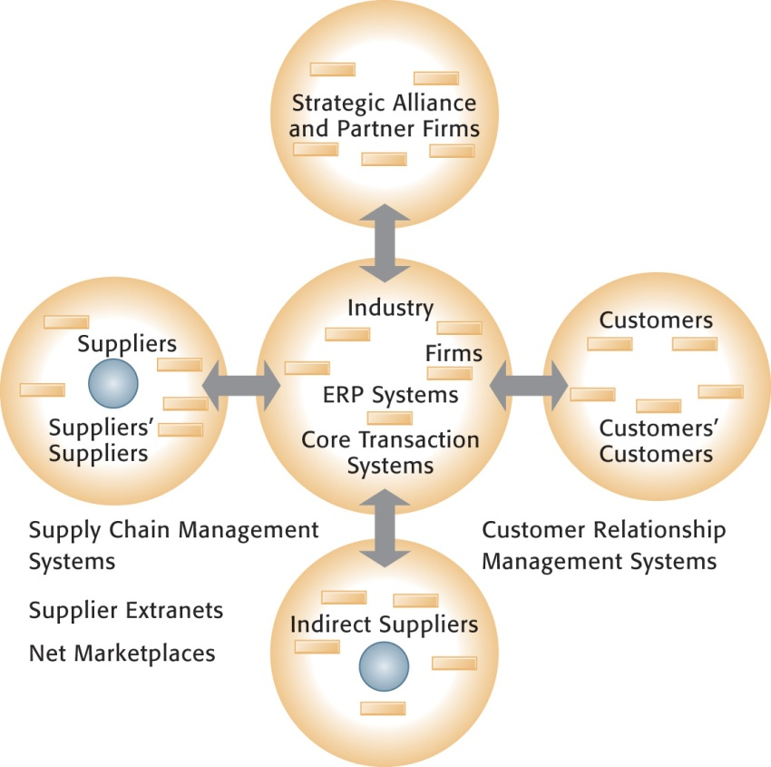
Using Information Systems to Achieve Competitive Advantage
The Value Web
The value web is a networked system that can synchronize the value chains of business partners within an industry to respond rapidly to changes in supply and demand.
Figure 3-3

Slide 17
Using Information Systems to Achieve Competitive Advantage
Synergies, Core Competencies, and Network-Based Strategies
Synergies:
When output of some units can be used as inputs to other units
When two firms can pool markets and expertise (e.g., recent bank mergers)
Lower costs and generate profits
Enabled by information systems that ties together disparate units so they act as whole
Notes:
Other competitive strategy models don’t focus on business processes and value chains, but instead focus on the core competency of a firm. Most times we don’t think about what firms are really good at, but the idea is for the firm to focus on what it really does well, better than anyone else, and to succeed by being the most efficient producer of best quality products and services. At the very least, firms should not be involved in a host of businesses where they are at best mediocre players. The role of IT in these models of competition is usually as a tool for achieving best-in-class products and services. This can include using IT as a collaboration tool, coordinating tool, and knowledge aggregator or store for the firm so that knowledge can be widely shared.

Slide 18
Using Information Systems to Achieve Competitive Advantage
Synergies, Core Competencies, and Network-Based Strategies
Core competency:
Activities for which firm is world-class leader
E.g., world’s best miniature parts designer, best package delivery service
Relies on knowledge that is gained over many years of experience as well as knowledge research
Any information system that encourages the sharing of knowledge across business units enhances competency
E.g., Procter & Gamble uses intranet to help people working on similar problems share ideas and expertise

Slide 19
Using Information Systems to Achieve Competitive Advantage
Synergies, Core Competencies, and Network-Based Strategies
Network-based strategies:
Network economics:
Marginal costs of adding another participant are near zero, whereas marginal gain is much larger
E.g., larger number of participants in Internet, greater value to all participants
Virtual company:
Uses networks to link people, resources, and ally with other companies to create and distribute products without traditional organizational boundaries or physical locations
Notes:
Network competitive strategies focus usually on Internet opportunities and companies. Here the emphasis is on products or services that can “go viral,” that is, take advantage of the fact that there are millions of people online, and if they generate positive messages about your product, in a few hours several million people will know about it. This explains why some services like Twitter, Facebook, and YouTube have grown with truly hockey-stick curves. Another different Internet (network) strategy is to use the Internet to find partners and collaborators who can magnify the power of your smaller firm.

Slide 20
Using Information Systems to Achieve Competitive Advantage
Disruptive Technologies: Riding the Wave
Disruptive technologies:
Technologies with disruptive impact on industries and businesses, rendering existing products, services and business models obsolete:
Personal computers
World Wide Web
Internet music services
First movers versus fast followers
First movers of disruptive technologies may fail to see potential, allowing second movers to reap rewards (fast followers)
Notes:
Most technologies throughout history have been “disruptive” in the sense that their use produces superior products and services at a fraction of the cost. Certainly, automobiles were a disruptive technology a hundred years ago which rather completely eliminated the buggy industry. The Internet is no different in rendering certain industries obsolete and unable to compete. Ask students to make a list with your help on industries that have been disrupted by the Internet.

Slide 21
Competing on a Global Scale
The Internet and Globalization
Prior to the Internet, competing globally was only an option for huge firms able to afford factories, warehouses, and distribution centers abroad
The Internet drastically reduces costs of operating globally
Globalization benefits:
Scale economies and resource cost reduction
Higher utilization rates, fixed capital costs, and lower cost per unit of production
Speeding time to market
Notes:
Certainly, one of the more disruptive impacts of the Internet has been to spread jobs out across a world labor market, with industrial jobs moving to the lowest-wage countries. In the past, communication barriers were so severe that it would be impossible to coordinate product and service development in both the United States and China, or India. Today, with instant Internet communications from e-mail, chat, and video cameras, the cost of operating globally has fallen, and even small firms work on a global basis today.

Slide 22
Competing on a Global Scale
Global Business and System Strategies
Domestic exporters
Heavy centralization of corporate activities in home country
Multinationals
Concentrates financial management at central home base while decentralizing production, sales, and marketing to other countries
Franchisers
Product created, designed, financed, and initially produced in home country but rely on foreign units for further production, marketing, and human resources
Transnationals
Regional (not national) headquarters and perhaps world headquarters; optimizing resources as needed
Notes:
There’s a lot of ways to set up a global information system. A lot depends on the type of company. Most companies today have large data centers spread around the world to handle their information needs on a regional basis. Some are more centralized than others. Generally, the trend was to allow regions considerable autonomy, but this strategy backfired as firms sought the efficiencies of a single global product, service, and database.

Slide 23
Competing on a Global Scale
Global System Configurations
Centralized systems:
All development and operation at domestic home base
Duplicated systems:
Development at home base but operations managed by autonomous units in foreign locations
Decentralized systems:
Each foreign unit designs own solutions and systems
Networked systems:
Development and operations occur in integrated and coordinated fashion across all units

Slide 24
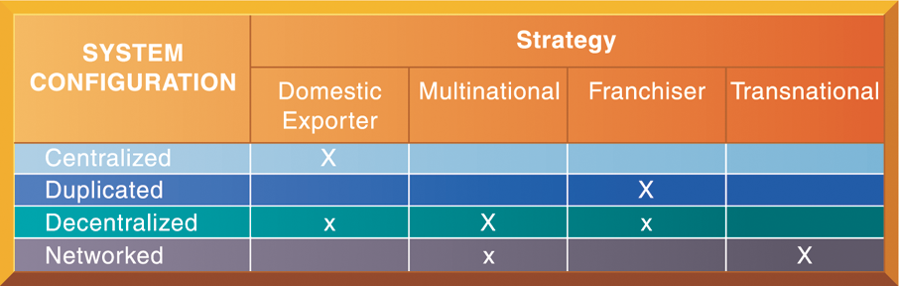
Competing on a Global Scale
Global Business Organization Systems Configurations
The large Xs show the dominant patterns, and the small Xs show the emerging patterns. For instance, domestic exporters rely predominantly on centralized systems, but there is continual pressure and some development of decentralized systems in local marketing regions.
Figure 3-5

Slide 25
Competing on Quality and Design
What Is Quality?
Producer perspective:
Conformance to specifications and absence of variation from specs
Customer perspective:
Physical quality (reliability), quality of service, psychological quality
Total quality management (TQM):
Quality control is end in itself
All people, functions responsible for quality
Six sigma:
Measure of quality: 3.4 defects/million opportunities
Notes:
Surely, one strategy is to produce the highest quality product or service, and charge accordingly. Information systems historically have placed a key role in the quality movement by enabling the measurement of quality, and helping managers model and optimize business processes.

Slide 26
Competing on Quality and Design
How Information Systems Improve Quality
Reduce cycle time and simplify production process
Benchmarking
Use customer demands to improve products and services
Improve design quality and precision
Computer-aided design (CAD) systems
Improve production precision and tighten production tolerances
Notes:
This slide lists some of the more common ways IS has played a central role in the quality movement.

Slide 27
NEXT
Notes:
This slide lists some of the more common ways IS has played a central role in the quality movement.

